Slide 1


Health Care Project - Hospital Readmissions Analysis
Identifying Key Factors &
Reducing Readmission Rate
An End-to-End Data Analysis Project
Using Python

Slide 2
Problem Statement
The management at Olive Hospital has noticed a significant increase in hospital readmissions, particularly among elderly patients. They aim to reduce readmission rates overall to make better use of available beds for new patients, utilize resources more efficiently, and improve patient satisfaction.

Slide 3
Project Process and Outline
The following steps will be taken in the project to formulate a recommendation:
Analyze the raw data to identify trends and patterns.
2. Identify the specific age groups with the highest readmission rates.
3. Examine the key factors that influence these readmissions.

Slide 4
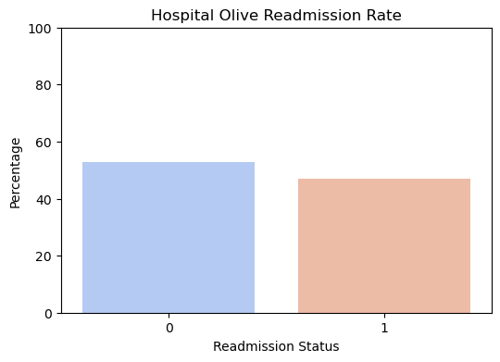
KPI’s Trends
The hospital readmission rate is 47.02% (higher than the industry average of 30%
0 – % of Admissions
1 – % of Readmissions
Hospital Olive Readmission Rate: 47.02%

Slide 5
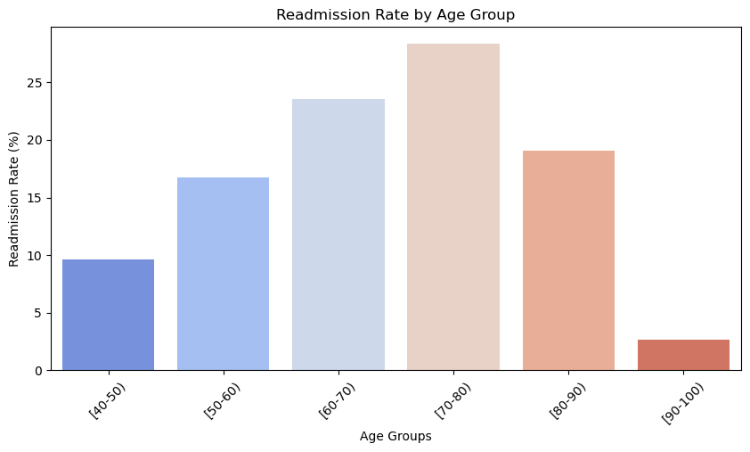
KPI’s Trends
Categorizing readmissions by age group
Top 2 Age Groups with Highest Readmission Rates:
(70-80) 28.38%
(60-70) 23.56%

Slide 6
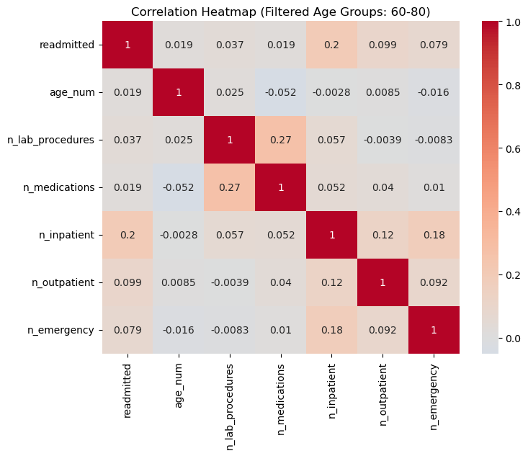
Correlation Analysis
Inpatient visits (0.20 correlation) have the highest positive impact on readmission.
Outpatient visits, emergency visits, lab procedures, and medications show very weak or no correlation.
Factor | Correlation | Strength
readmitted | 1.000 | Perfect Positive
n_inpatient | 0.200 | Weak Positive
n_outpatient | 0.099 | Very Weak/No Correlation
n_emergency | 0.079 | Very Weak/No Correlation
n_lab_procedures | 0.037 | Very Weak/No Correlation
age_num | 0.019 | Very Weak/No Correlation
n_medications | 0.019 | Very Weak/No Correlation

Slide 7
Conclusion and Recommendations
Recommendations
Enhance Post-Discharge Care for Inpatients
Improve discharge planning and schedule follow-ups.
Implement telemedicine check-ups to monitor recovery.
Strengthen Transitional Care Programs
Assign case managers for high-risk and elderly patients.
Offer home healthcare services to reduce unnecessary readmissions.
3. Improve Patient Education and Chronic Disease Management
1. Conduct educational programs on self-care and lifestyle adjustments.
2. Provide support groups and coaching for chronic disease management.
Conclusion:
Inpatient hospitalization is the most significant factor.
Better post-discharge management and patient education can reduce readmission rates.

Slide 8

ANY QUESTIONS? LET US CONNECT

